Slide 1
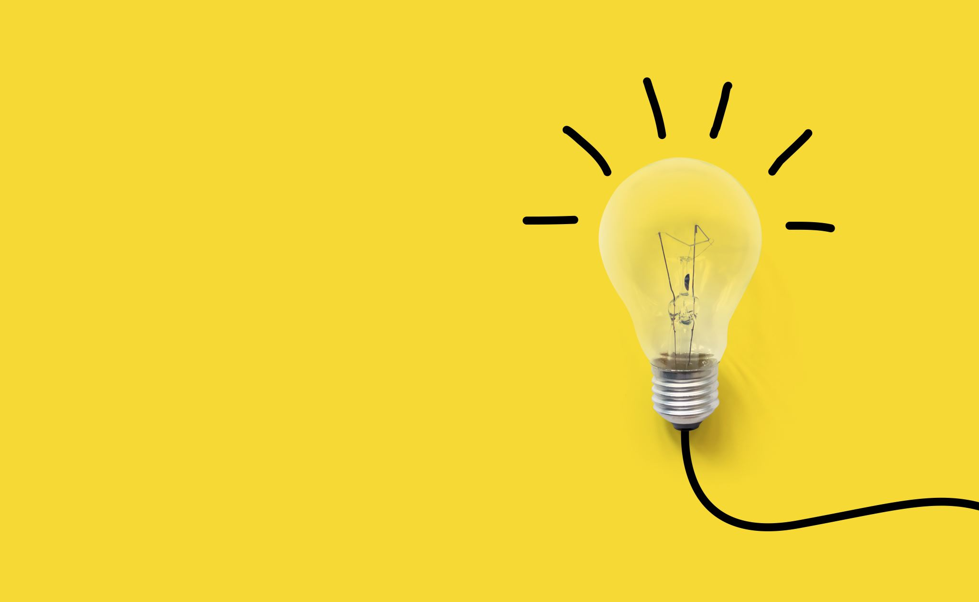
optimal liquidation strategy using ddpg
Samuel atkins

Slide 2
Presentation breakdown
DDPG Algorithm
Motivation
In-Depth Actor-Critic Network Visualization
Liquidation DRL Formulation
State-space
Observations
Rewards
Multi-Agent Interaction
Motivation
Co-op vs. Competitive Reward Formulation & Results

Slide 3
DDPG Motivation
Goal of RL algorithm:
Learn a near-optimal policy that maximizes the “reward function”

Slide 4
1. DDPG Algorithm
Action
Action
Actor Network
Critic Network
Observation
Observation
Action

